Slide 1

Housing Price Prediction
in King County
Team 3: Ana Maharjan, Aleks Lazowski,
Sripada Sri Amruta, Geech Hor Huot

Slide 2
Project Overview

Slide 3
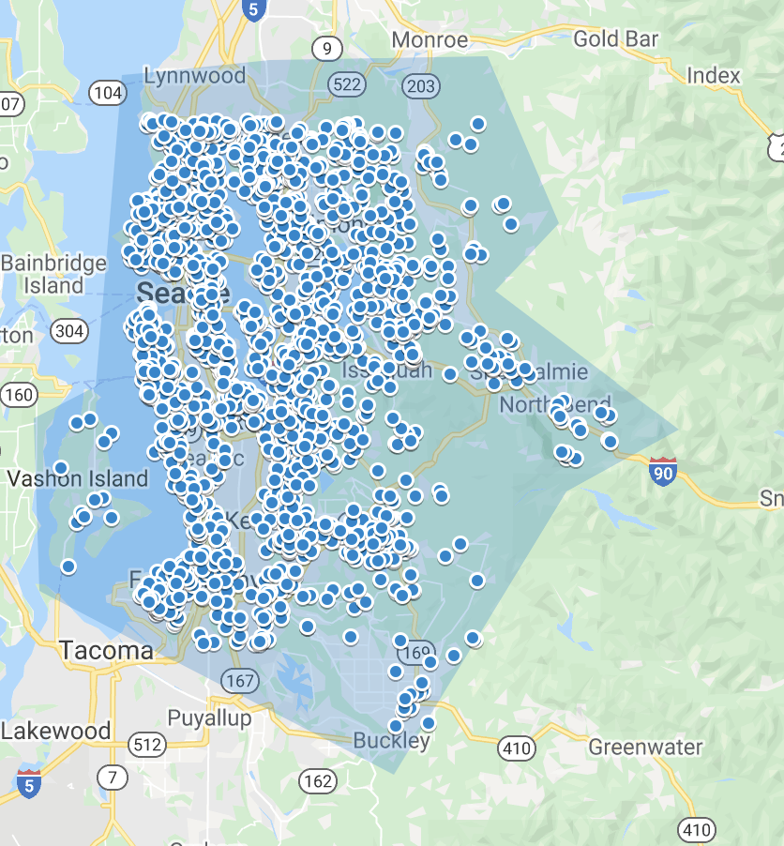
Project Overview
Which Housing Features Influence Housing Prices in King County?
Drive Real Estate Investment Decisions
Understand Factors that Drive Price
Estimate Valuation of Houses
Provide Recommendations to Renovators for Maximizing Profit
Downloaded: Kaggle
Original Source: GIS Open Data (GIS King County)
Notes:
Which variables matter most to consumers (buyers)?
Why some factors lead to purchases over others
What makes a property higher valued?
How the housing market fluctuates
Value of houses based on location and style
Valuable to developers or investors looking to purchase property in the area.
Help sellers estimate a sell price for the property
Deciding on the renovation technique to maximize profit.

Slide 4



Variable Description
Columns: 21 (str, int, float)
Rows: 21,613
Geography
Housing Features
Target Variable
Waterfront
View
Zip code
Bedrooms
Bathrooms
Sqft Lot
Sqft Living
Floors
Condition
Year Built
Renovated
Price
Notes:
Zip code: removed-- they were not matching the exact counties, we plan to explore the lat and long columns instead for geographical mapping
Year Renovated: Changed to boolean format 0-1, 0= no renovation 1=renovated
Removed: there were 4 different sqft variables- we just kept the sqft lot and living variable and not take the grouping variable

Slide 5
Exploratory Analysis

Slide 6
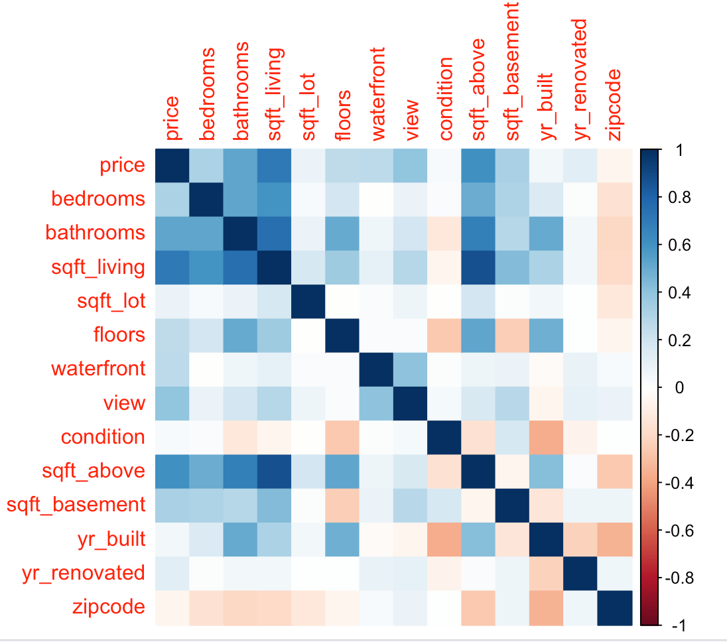
HEAT MAP ON VARIABLE CORRELATION
Variables with Correlation
> 0.5
Sqft Living
Sqft Above
Bathrooms

Slide 7
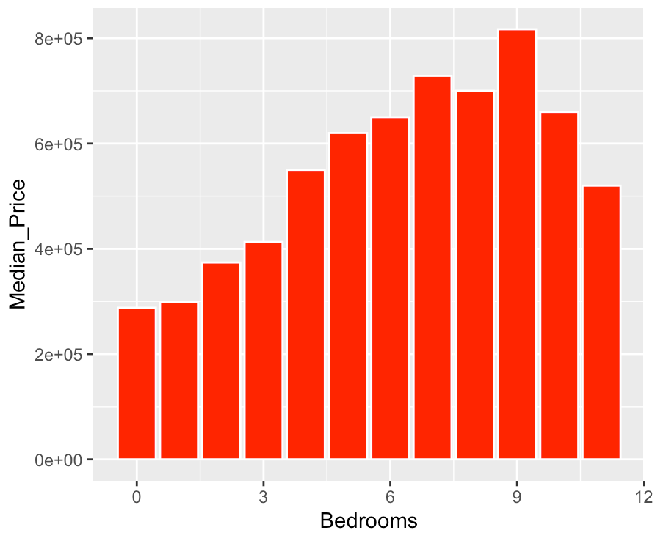
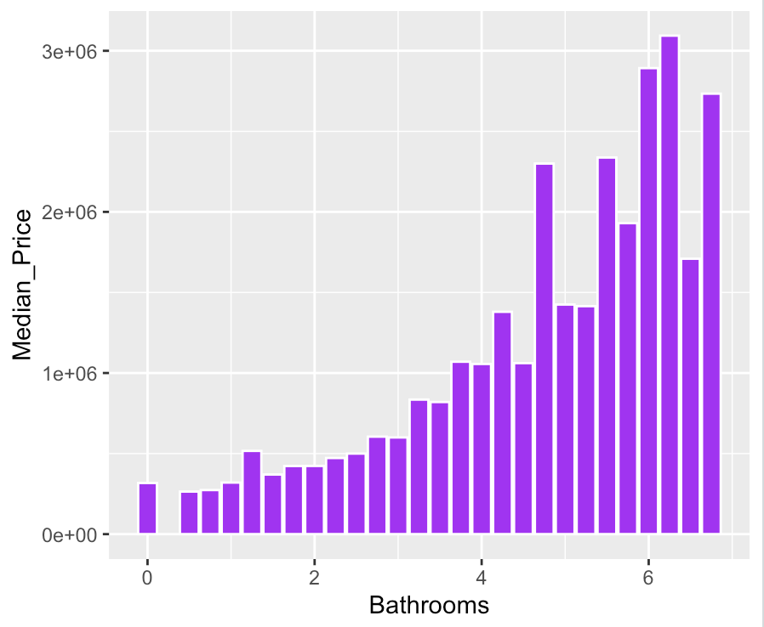
Exploratory Data Analysis
How does number of bedrooms and bathrooms impact the price of a house in King County?

Slide 8
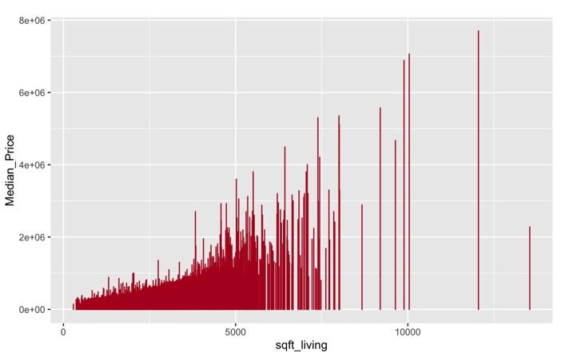
How do the Sq.ft-living fluctuate the price of a house in King County?
House price increased with the increase in square foot living
House prices below 500,000 dollars have less than 2500 square living area.

Slide 9
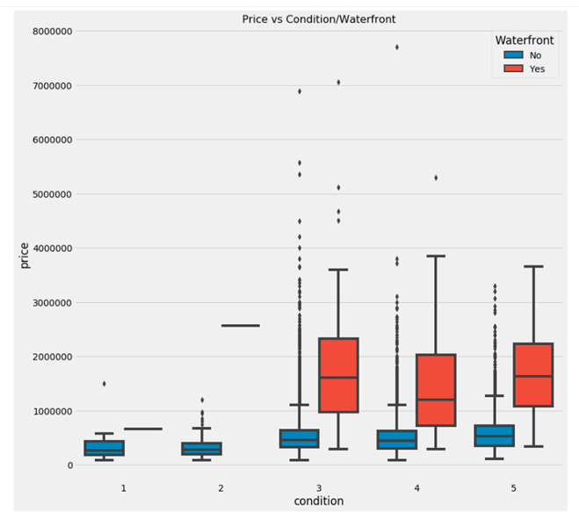
Do higher condition scores and having a waterfront view raise the price of a house?
Homes of conditions 3+ were more expensive than of condition 2 or lower irrespective of waterfront status.
Interestingly enough, condition 3 and 5 houses had higher median values than homes of condition 4.
The price of the house only increases until a certain price and thereafter the presence of waterfront view do not impact the price a lot.

Slide 10
Model Evaluation

Slide 11
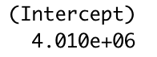
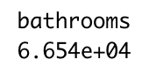
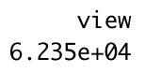
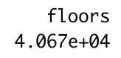
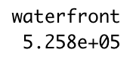
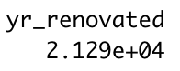
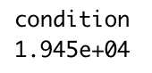
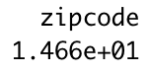
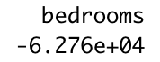
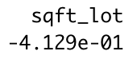
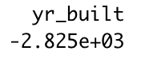
RMSE Train: 234,856.6
RMSE Test: 220,615.2
Mean: 540,088
Linear Regression
Model Coefficients
Multiple R-squared:
0.6007
Positive coefficients
Negative
coefficients
Every unit increase in variables like bathroom, we see an price increase $20,000 or more.
Notes:
R square shows how well the model fits with the observed data

Slide 12
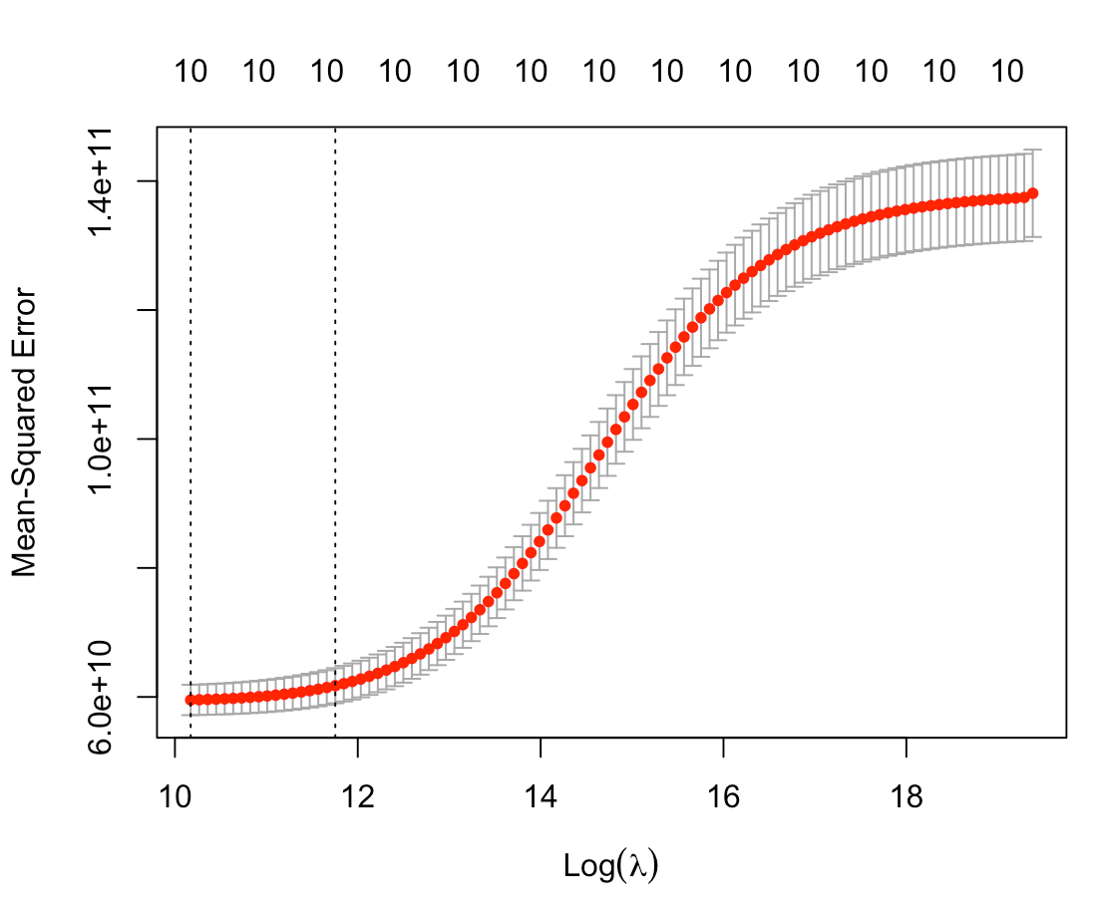
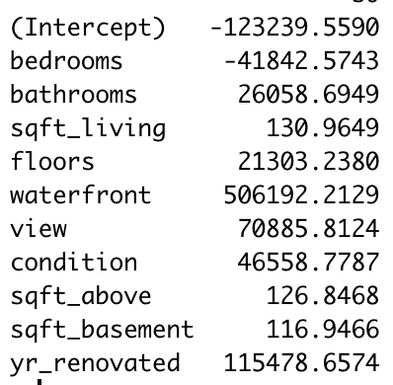
RMSE Train: 243,555.8
RMSE Test: 229,134.3
Mean: 540,088
Ridge Regression
Smallest Mean Squared Error appears in the beginning.
Small error margin
Coefficients improved
Bedrooms only negative relation

Slide 13
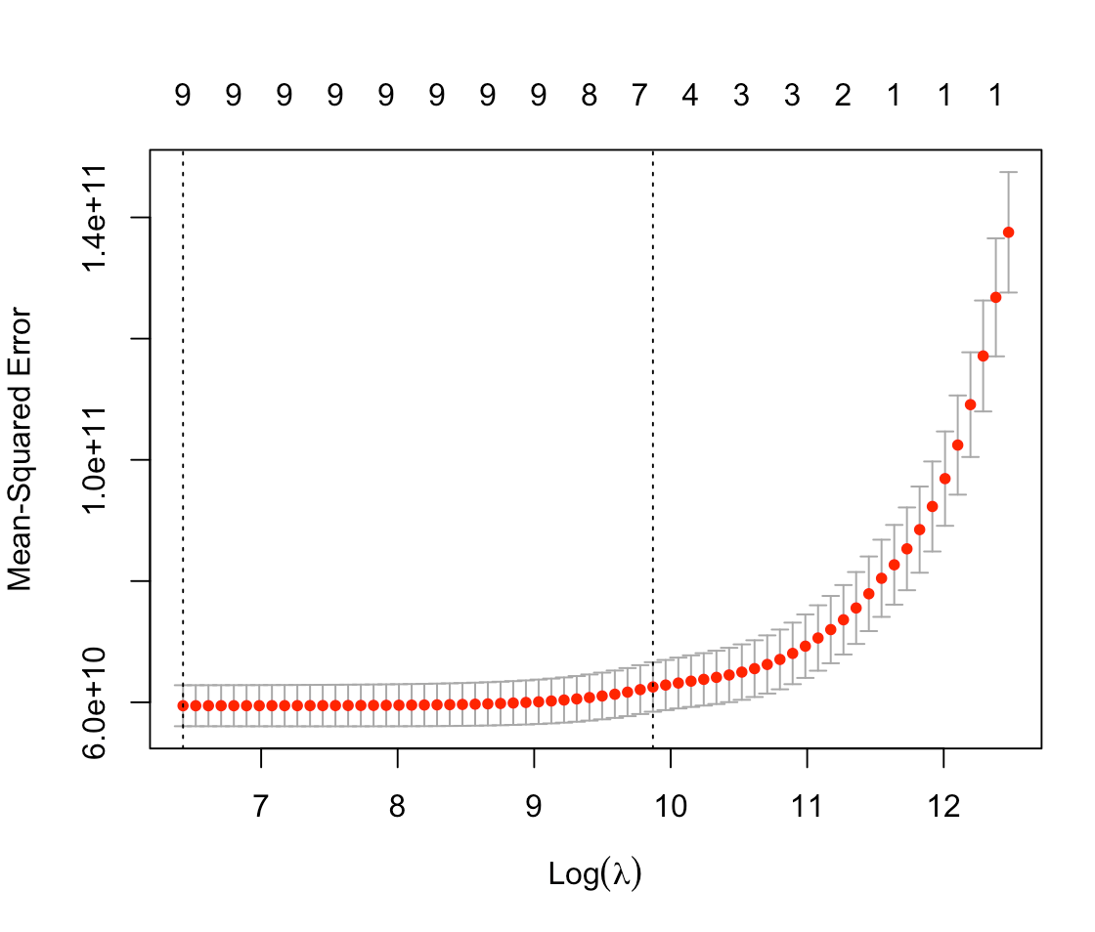
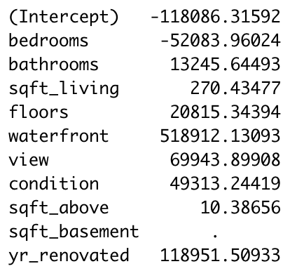
RMSE Train: 243,126.5
RMSE Test: 228,983.0
Mean: 540,088
Lasso Regression
Lasso brought coefficients set basement at zero
Minor changes for other variables on price
Smallest Mean Squared Error appears in the beginning.
Much wider error margin
Notes:
Coefficient chart shows the predictors coefficients scores as a function of log(λ) indicating the shrinkage of coefficients for larger numbers of log(λ)

Slide 14
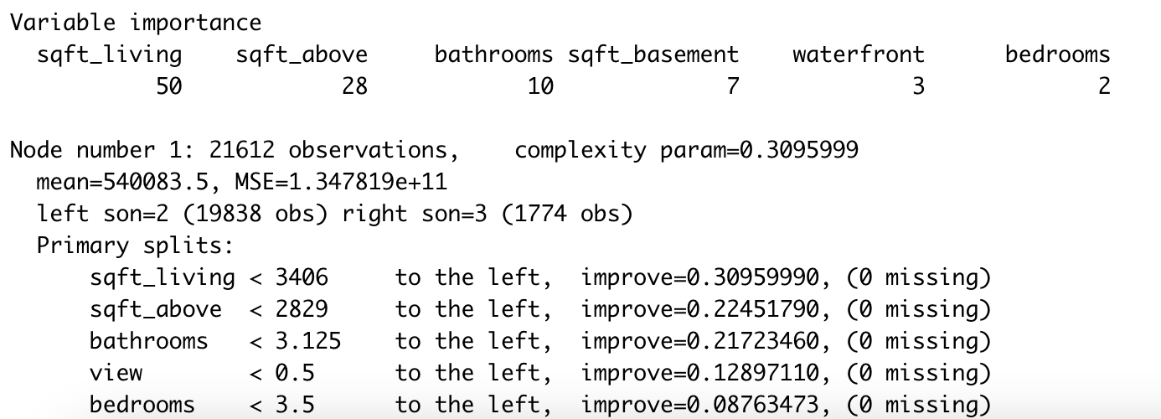
RMSE Train: 245,242
RMSE Test: 233,987
Mean: 540,088
Regression Tree
Notes:
1:27 secs
Using the packages Rpart and Rpartplot we first create the equation for the model with price as the target variable.
We begin the tree with about 22K observations. We start at the root, where our first split is whether the house is less than 3406 for sqft living. The first variable holds the highest predictive power, which is why the tree starts the split here. Now to demonstrate in a more visual way, this is what our tree looks like

Slide 15
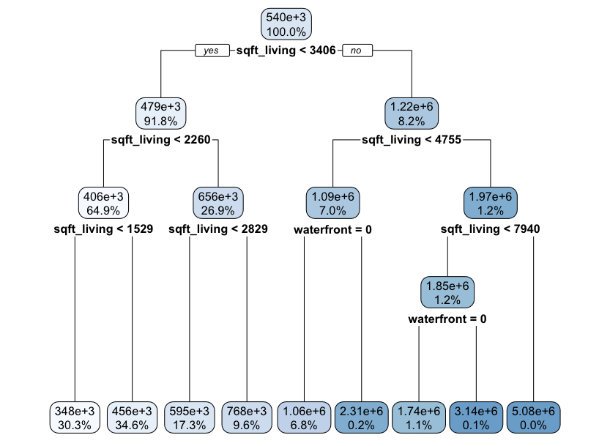
Regression Tree
Highest Price: $3.4 M (0.1%)
Sqft Living: 4755 - 7940
Waterfront
Lowest Price: $348K (30.3%)
Sqft Living < 1529
Notes:
We start at the root, and then the first split is determined by sqft living- which holds the highest predictive power. All these lead to the leaf nodes at the bottom. The predictions are calculated by taking the average of each subset of the data. The percentage in the leaf tells us the total number of percentages that ended up in that path.

Slide 16
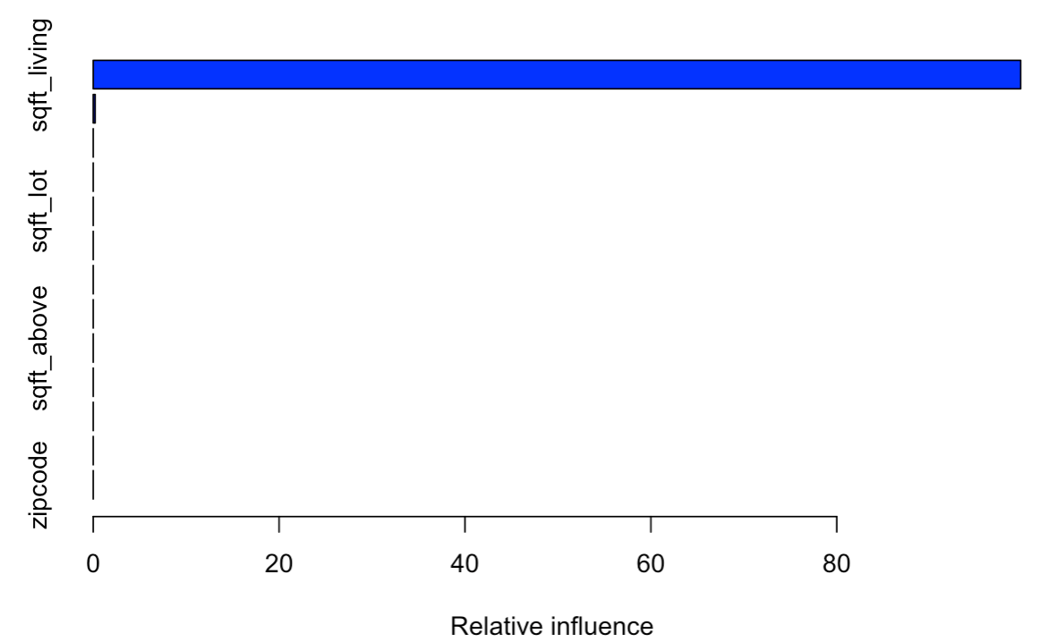
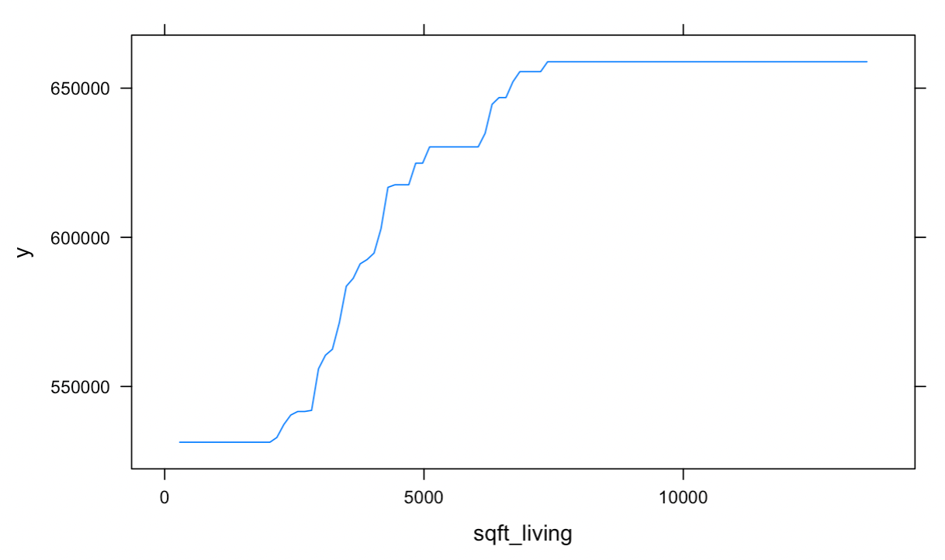
Gradient Boosted Model
(with Gaussian Loss function)
RMSE Train: 357,553.81
RMSE Test: 335,563.50
Mean: 540,088
100 iterations
13 predictors: 2 had non-zero influence
Summary of the model gives a feature importance plot

Slide 17

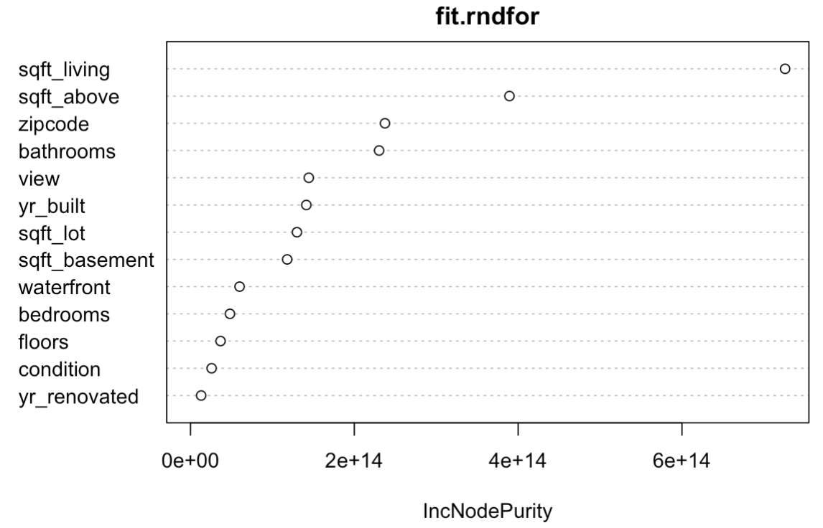
Best Model: Random Forest
Number of trees = 500
RMSE= 86,985.02
RMSE = 172,788.16
The difference between the predicted price (yhat) and the actual price is lowest reflecting on how well can the model predict the price of the house. .
Notes:
Our final and chosen model that works the best is Random Forest because it has RMSE train of 172 thousand and the lowest among all the other model. For Random Forest, there are 500 trees total. As expected, the feature importance plot also showed that sqft_ living has the most influence to the house price as well.

Slide 18
Conclusion

Slide 19
Challenges
Location Challenge:
Zipcode is a general area which had some overlapping in different counties.
But we found zipcode to be more interpretable
Averages of lat, long wouldn’t be helpful
No extra exploratory analysis
Scaling in Ridge and Lasso Plots:
High MSEs due to house price
Lambda sequence didn't fit the data
Had to change the lambda sequence to fit the range

Slide 20
Conclusion
Summary
Recommendations
Best Model: Random Forest
RMSE Test: 173K
Variables that positively influence price:
Sqft Living
Sqft Above
Bathrooms
Variables that do not influence price:
Condition
Renovated
Leverage high value variables to maximize profits (sellers)
Sqft Living*
Understand which variables may lead to higher prices and which factors do not influence price
Find undervalued homes that have features relating to higher prices and invest in these assets
Notes:
1:35 secs
Sellers: Maximize selling price if you have any of the ‘high value’ variables
Buyers: Knowing which variables increase price the most, can help buyers find the best deal according to their preferences.
Investors: Make decisions based on factors that increase price. Find undervalued houses that have all features relating to higher price.

Slide 21





Thank you! Questions?
Ana Maharjan
Geech Hor Huot
Aleks Lazowski
Sri Amruta Sripada

Slide 22
APPENDIX

Slide 23
Glossary of Variables with Definitions
Id: Unique ID for each home sold
Date: Date of the home sale
Price: Price of each home sold (target)
Bedrooms: Number of bedrooms
Bathrooms: Number of bathrooms, where .5 accounts for a room with a toilet but no shower
Sqft_living: Square footage of the apartments interior living space
Sqft_lot: Square footage of the land space
Floors: Number of floors
Waterfront: A dummy variable for whether the apartment was overlooking the waterfront or not 10.View: An index from 0 to 4 of how good the view of the property was 11.Condition: An index from 1 to 5 on the condition of the apartment,
Grade: An index from 1 to 13, where 1-3 falls short of building construction and design, 7 has an average level of construction and design, and 11-13 have a high quality level of construction and design
Sqft_above: The square footage of the interior housing space that is above ground level
Sqft_basement: The square footage of the interior housing space that is below ground level
Yr_built: The year the house was initially built
Yr_renovated: The year of the house’s last renovation
Zipcode: What zipcode area the house is in
Lat: Lattitude
Long: Longitude
Sqft_living15: The square footage of interior housing living space for the nearest 15 neighbors
Sqft_lot15: The square footage of the land lots of the nearest 15 neighbors

